Slide 1
Blacktown Chinese Christian Church
Welcome to Our English Service 23.03.2025
English Service 9:45 – 11:00 am
Worship Songs: Passage: Speaker: Topic: Response Song: Announcements and Closing Prayer Benediction
Every Step King Of Kings My Labour Is Not In Vain Genesis 37: 2-11 TBA TBA TBA

Slide 2
BCCC english service

Slide 3

Please keep all phones on silent

Slide 4
Every Step
Ian Lewis, James Ferguson © CityAlight Music (Admin. by Integrity Music) CCLI Licence No. 5485849 . CCLI Song number: 7199816

Slide 5
Verse 1
I can sing with my whole heart, I have all I need
In Jesus, my Saviour, my joy is complete
Onward to glory yet here I will wait
I will trust in Christ every step I take

Slide 6
Verse 2
I am sure of Your promise to guide me each day
Though some may oppose me, I won't be ashamed
Whatever I face, Lord, it won't be in vain
I will trust in Christ every step I take

Slide 7
Chorus
For all of my days, I will live for Your glory
Running with courage and faith
The prize of my journey, the joy of salvation
To meet my King face to face

Slide 8
Verse 3
So I'm looking to Jesus, perfector of faith
My heart set on heaven where treasure awaits
I'll run with endurance to finish the race
I will trust in Christ every step I take

Slide 9
Chorus
For all of my days, I will live for Your glory
Running with courage and faith
The prize of my journey, the joy of salvation
To meet my King face to face

Slide 10
Bridge
I will, I will rejoice
Whatever comes my way
God You're faithful to save

Slide 11
Bridge
I will, I will rejoice
I know that God is with me always

Slide 12
Bridge
I will, I will rejoice
Whatever comes my way
God You're faithful to save

Slide 13
Bridge
I will, I will rejoice
I know that God is with me always

Slide 14
Bridge
I will, I will rejoice
Whatever comes my way
God You're faithful to save

Slide 15
Bridge
I will, I will rejoice
I know that God is with me always

Slide 16
Chorus
For all of my days, I will live for Your glory
Running with courage and faith
The prize of my journey, the joy of salvation
To meet my King face to face

Slide 17
Tag
To meet my King face to face
To meet my King face to face

Slide 18
King Of Kings
Beau Lamshed, Jason Tarau © 2016 Citipointe Worship (Admin. by Crossroad Distributors Pty. Ltd.) CCLI Licence No. 5485849 . CCLI Song number: 7102191

Slide 19
Verse 1
In the darkness we were waiting
Without hope, without light
Till from heaven You came running
There was mercy in Your eyes

Slide 20
Verse 1
To fulfill the law and prophets
To a virgin came the word
From a throne of endless glory
To a cradle in the dirt

Slide 21
Chorus
Praise the Father, praise the Son
Praise the Spirit, three in one
God of glory, Majesty
Praise forever to the King of Kings

Slide 22
Verse 2
To reveal the kingdom coming
And to reconcile the lost
To redeem the whole creation
You did not despise the cross

Slide 23
Verse 2
For even in your suffering
You saw to the other side
Knowing this was our salvation
Jesus for our sake you died

Slide 24
Chorus
Praise the Father, praise the Son
Praise the Spirit, three in one
God of glory, Majesty
Praise forever to the King of Kings

Slide 25
Verse 3
And the morning that You rose
All of heaven held its breath
Till that stone was moved for good
For the Lamb had conquered death

Slide 26
Verse 3
And the dead rose from their tombs
And the angels stood in awe
For the souls of all who'd come
To the Father are restored

Slide 27
Verse 4
And the Church of Christ was born
Then the Spirit lit the flame
Now this gospel truth of old
Shall not kneel, shall not faint

Slide 28
Verse 4
By His blood and in His name
In His freedom I am free
For the love of Jesus Christ
Who has resurrected me

Slide 29
Chorus
Praise the Father, praise the Son
Praise the Spirit, three in one
God of glory, Majesty
Praise forever to the King of Kings

Slide 30
Outro
Praise forever to the King of Kings

Slide 31
My Labour Is Not In Vain
CCLI Licence No: 5485849

Slide 32
Verse 1
My work in Christ is not in vain
My labor will not fail
For when I toil in Jesus’ name
His purpose will prevail

Slide 33
Verse 2
The tasks that You have set for me
I may not understand
Yet I will follow where You lead
I trust Your sovereign hand

Slide 34
Chorus
So may all I do, be it great or small
Bring glory to Your name

Slide 35
Chorus
In Your grace alone I will car – ry on
Your promise to me remains
My labour is not in vain

Slide 36
Verse 3
Go forth, You said, take up your cross
And set the captive free
So give me feet to seek the lost
Just as You searched for me

Slide 37
Chorus
So may all I do, be it great or small
Bring glory to Your name

Slide 38
Chorus
In Your grace alone I will car – ry on
Your promise to me remains
My labour is not in vain

Slide 39
Verse 4
Take heart, my soul, and persevere
Just as your Saviour did
For soon you will be home at rest
Your work, complete in Him

Slide 40
Chrous
So may all I do, be it great or small
Bring glory to Your name

Slide 41
Chrous
In Your grace alone I will car – ry on
Your promise to me remains
My labour is not in vain

Slide 42
Chrous
So may all I do, be it great or small
Bring glory to Your name

Slide 43
Chrous
In Your grace alone I will car – ry on
Your promise to me remains
My labour is not in vain

Slide 44

Bible reading

Slide 45
Genesis 37: 2-11 (NIV)
² This is the account of Jacob’s family line.
Joseph, a young man of seventeen, was tending the flocks with his brothers, the sons of Bilhah and the sons of Zilpah, his father’s wives, and he brought their father a bad report about them.
³ Now Israel loved Joseph more than any of his other sons, because he had been born to him in his old age; and he made an ornate robe for him.

Slide 46
Genesis 37: 2-11 (NIV)
⁴ When his brothers saw that their father loved him more than any of them, they hated him and could not speak a kind word to him.
⁵ Joseph had a dream, and when he told it to his brothers, they hated him all the more.

Slide 47
Genesis 37: 2-11 (NIV)
⁶ He said to them, “Listen to this dream I had: ⁷ We were binding sheaves of grain out in the field when suddenly my sheaf rose and stood upright, while your sheaves gathered around mine and bowed down to it.”

Slide 48
Genesis 37: 2-11 (NIV)
⁸ His brothers said to him, “Do you intend to reign over us? Will you actually rule us?” And they hated him all the more because of his dream and what he had said.
⁹ Then he had another dream, and he told it to his brothers. “Listen,” he said, “I had another dream, and this time the sun and moon and eleven stars were bowing down to me.”

Slide 49
Genesis 37: 2-11 (NIV)
¹⁰ When he told his father as well as his brothers, his father rebuked him and said, “What is this dream you had? Will your mother and I and your brothers actually come and bow down to the ground before you?” ¹¹ His brothers were jealous of him, but his father kept the matter in mind.

Slide 50
Scripture quotations taken from The Holy Bible, New International Version® NIV®
Copyright © 1973, 1978, 1984, 2011 by Biblica, Inc.
Used with permission. All rights reserved worldwide.

Slide 51
Announcements

Slide 52





Account name: Blacktown Chinese Christian Church
Account number: 4216 50263
Offering
BSB: 112 - 879
Please put in "offering" as the reference
The offering box is available at the back of the hall

Slide 53
Prayer points

Slide 54
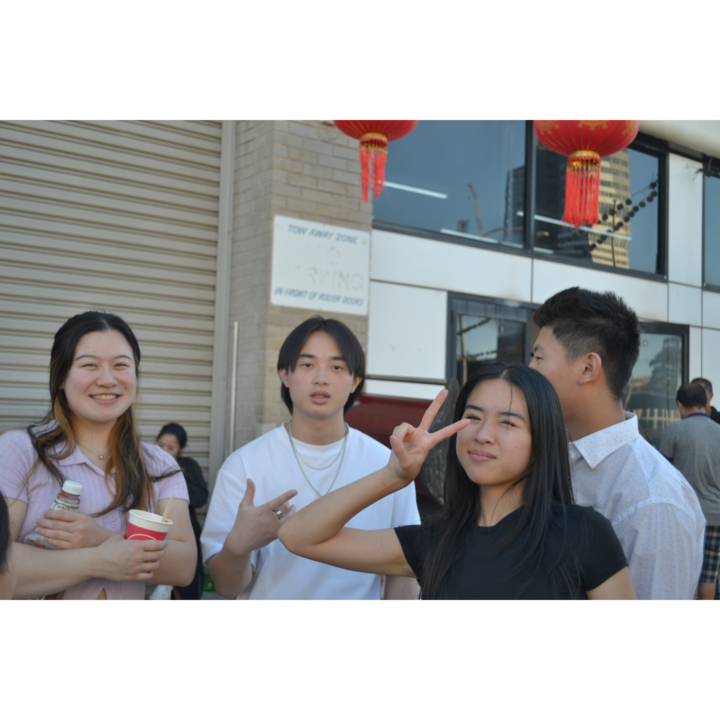
Mingle time!

